Slide 1
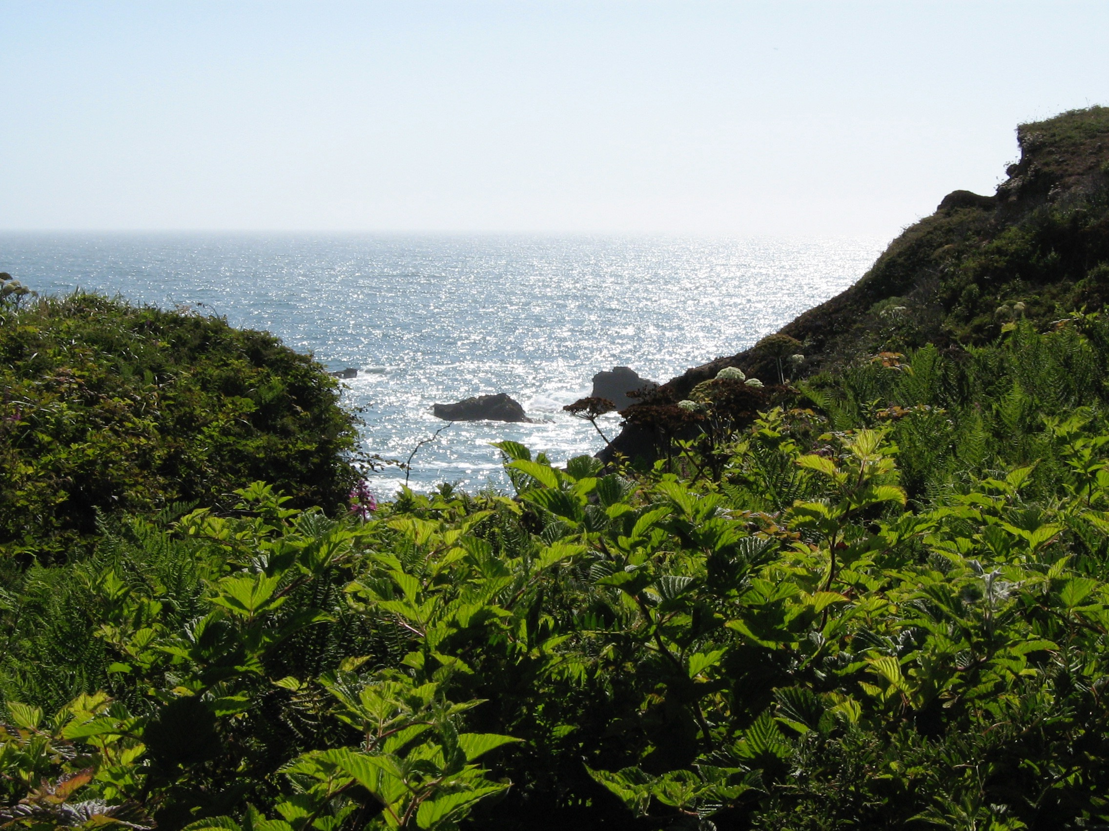

Slide 2
GRATITUDE, CELEBRATION, AND THE POWER OF SECOND CHANCES

Slide 3
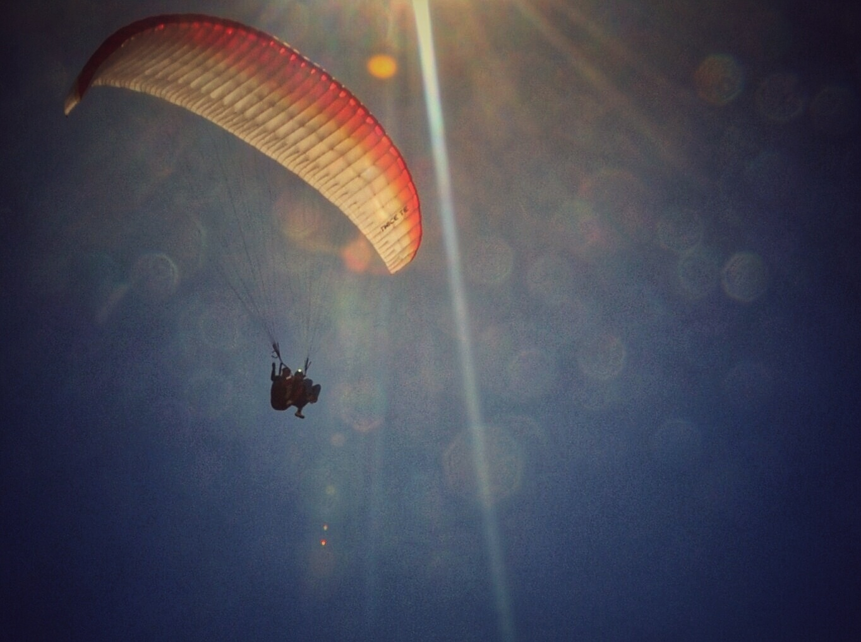

Slide 4
UNSTOPPABLE TOOLS from special forces:
View fear/stress as a guide, accept it, even welcome it because it keeps you sharper
Set mini-goals, celebrate and feel gratitude
Sense of humor — keeps you flexible, positive
Knowledge is power — learn as much as you can about the thing that is feared or that stresses you
Role Models — learn from positive & negative ones

Slide 5
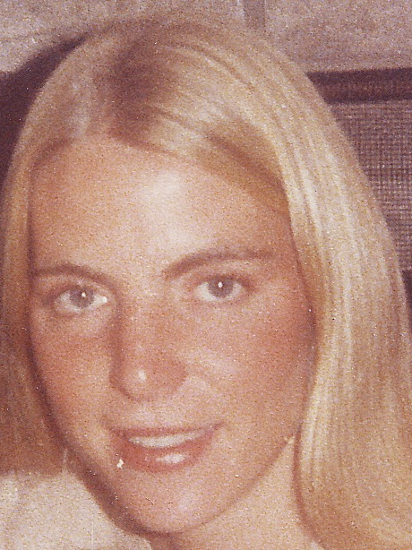
I am a survivor of human trafficking.
Vulnerabilities:
History of Childhood Sexual Abuse
History of SUD, Trauma
Poverty, Desperation

Slide 6
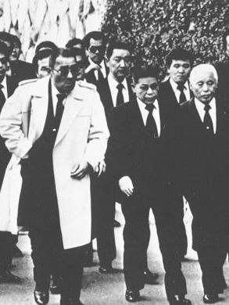
What is Human Trafficking?
Federal law defines trafficking in persons as, “...sex trafficking in which a commercial sex act is induced by force, fraud, or coercion, or in which the person induced to perform such act has not attained 18 years of age...”
Human Trafficking is the fastest growing and second largest criminal industry in the world, generating roughly $32 Billion a year

Slide 7
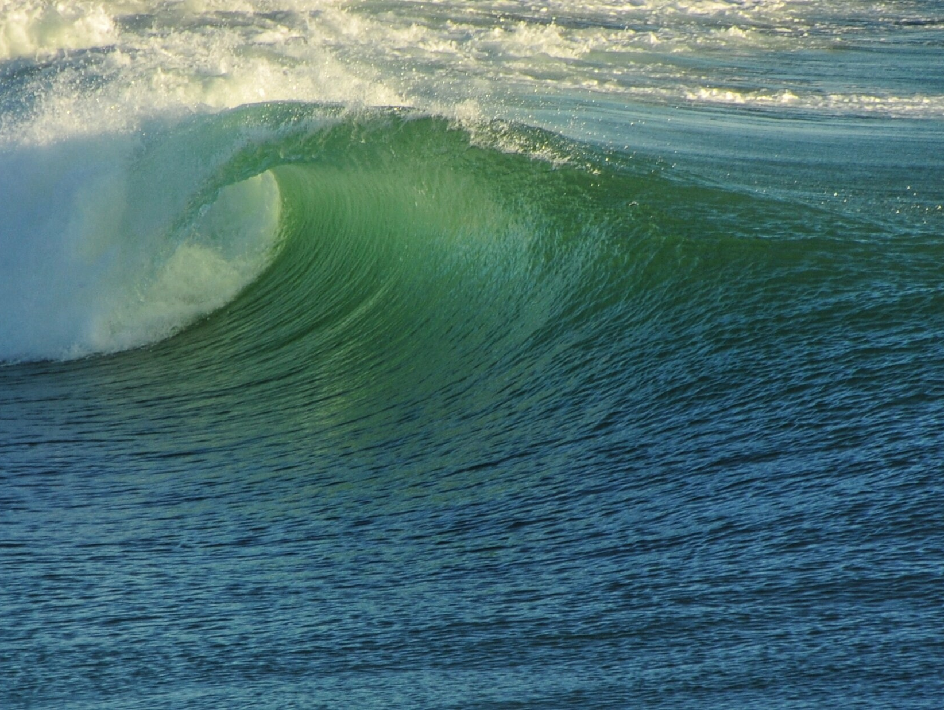

Slide 8
facts
Addiction: Compulsive use of a substance despite negative or dangerous effects. (Bio-Psycho-Social)
Addiction disrupts the hard wiring of the brain. It is not a moral weakness or a lack of willpower.
Recovery is the creation of a new lifestyle, re-wiring the brain. 23.5 million adults in U.S. are in recovery.
One Big Risk Factor is the age you start using. In our early teenage years, our brains are most plastic. Early use can affect memory and emotional maturation.

Slide 9
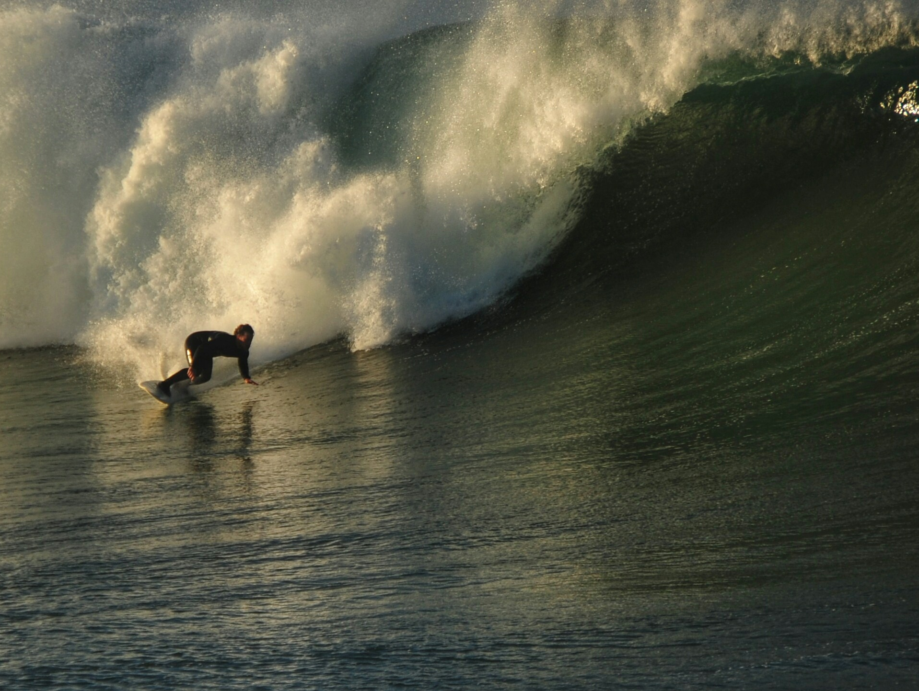

Slide 10
STRONG FOUNDATION FOR RECOVERY AND WELLNESS
Courage, combined with love, is unstoppable.
Recovery is a plan of action. You are not your thoughts. It is your actions that define you.
Compassion and kindness toward self and others creates unlimited “second chances” for healing.
It’s empowering to realize that the happiness you experience today is because of, not in spite of, the things you’ve overcome. Celebrate & give thanks.

Slide 11
UNSTOPPABLE tips from special forces
Remember your strengths, look for ways to increase and build your strengths
Stay connected to your team and protect your team
Moral compass — tap into “spiritual fitness” religion and spirituality, drawing faith from them
Altruism: Unselfish regard for the welfare of others
You can “Act as if” when facing any challenge
Positive emotions are more contagious than negative

Slide 12
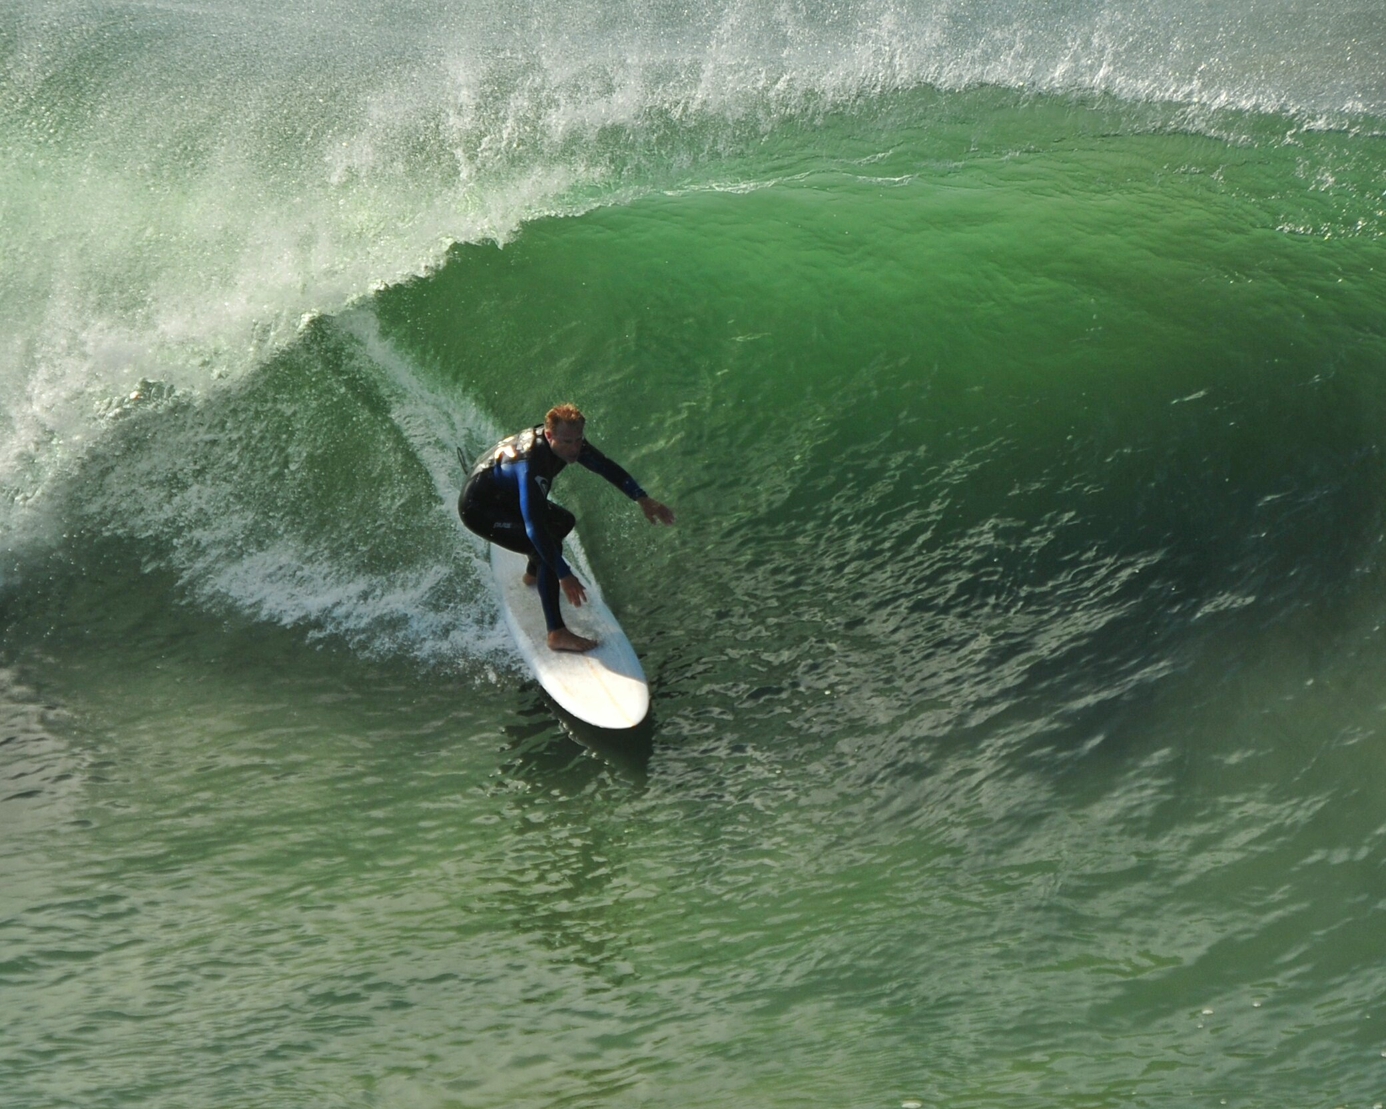

Slide 13
UNSTOPPABLY GOOD LIFE LESSONS
What may look like luck to some is actually the result of staying the course, networking & contacts.
Be kind to yourself and others. We all carry burdens. Kindness is brave.
Positive visualization works. (Many ways to do this)
Your voice is an instrument. It’s not only the words you say, but the power you project. Power yourself up with mini pep talks throughout the day, and when preparing to meet challenges.

Slide 14
More UNSTOPPABLY GOOD LIFE LESSONS
Stress management skills enhance & strengthen your creativity in work and in life.
Gratitude & celebration fuel motivation and a sense of well-being. Navy Seals set & celebrate mini-goals.
Remember: Nobody is above you and nobody is below you. You never have to compensate for any perceived shortcoming, or compare yourself to others. Be proud of who you are and what you do.
Mindfulness meditation builds your personal power.

Slide 15
and MORE UNSTOPPABLY GOOD STUFF
Get Connected & Stay Connected
Face Fear: Knowledge = Power
Develop Your Action Plan: Why > How
Keep Hope Alive: Celebrate & Give Thanks
Embrace a Positive Mindset + Optimism
Win with Mantras and Affirmations

Slide 16
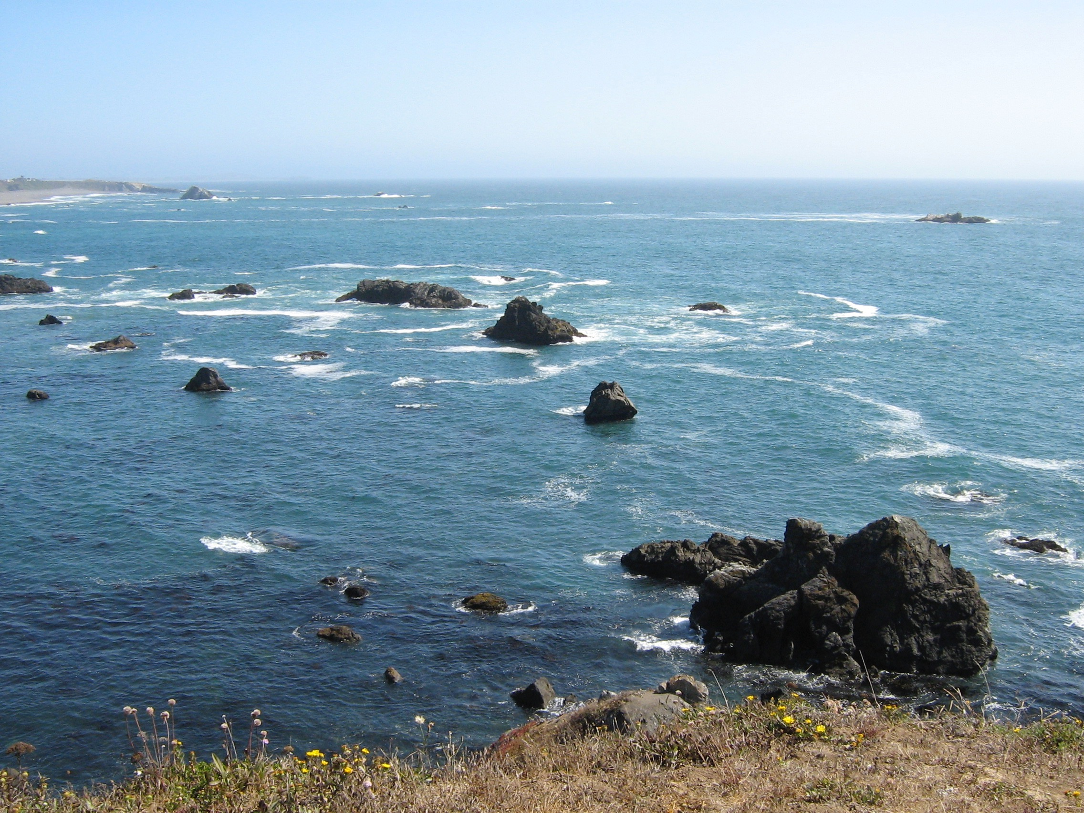

Slide 17
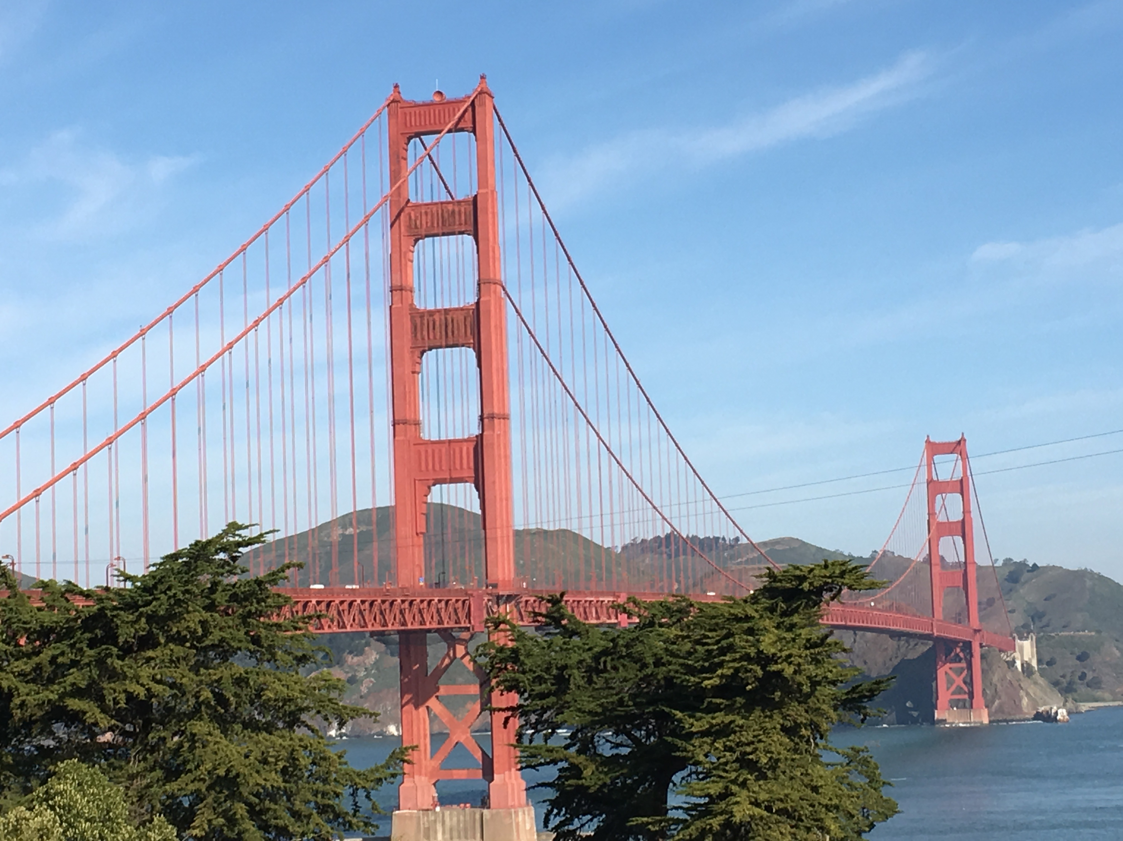

Slide 18
REINFORCE YOUR FOUNDATION: WHEN SOMETHING GOOD HAPPENS, SAVOR IT
Give yourself credit for whatever part you played in making it happen.
Allow yourself to feel grateful for any part you didn’t play in it — help from others or just plain luck.
Get the most of it — think of ways to expand the reach of the good thing and make it last — celebrate it, replay it in your mind, feel proud, happy, relieved

Slide 19
YOU’RE STRONGER, braver, AND kinder THAN YOU THINK
Take a few minutes to thank yourself for two or three things you’ve accomplished that made your life better.
Take some time to thank yourself for two or three things you’ve done that made someone else happier or safer.
Think of/jot down two things you do in life that you take for granted, but would be seen as super-strong and brave by someone in another line of work.

Slide 20
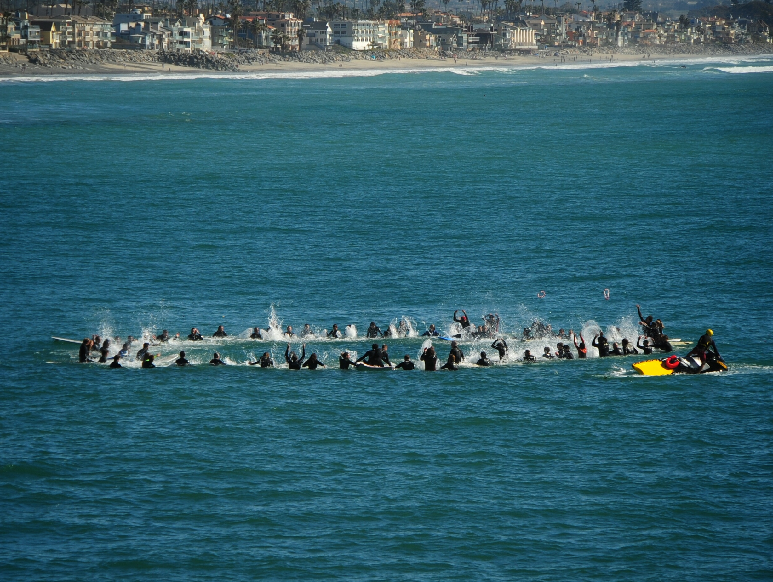

Slide 22
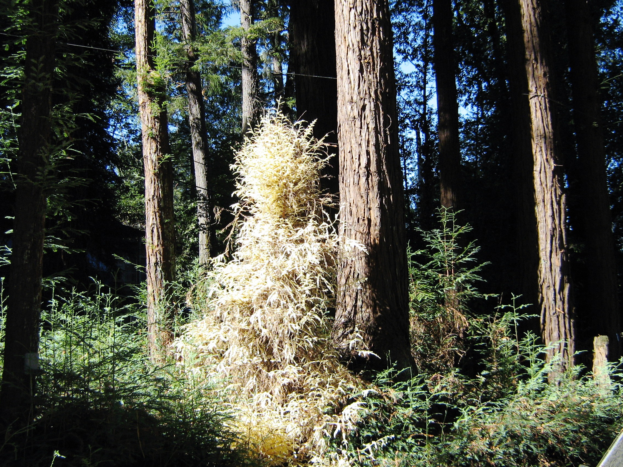
One in ten million
Live as if everything is a miracle.

Slide 23
Resources
Resilience: The Art of Mastering Life’s Greatest Challenges, by S. Southwick and D. Charney
Partnership for Drug-Free Kids
Stanford Medicine Archives
Man’s Search for Meaning, by Viktor Frankl
International Labor Organization
Terence T. Gorski, CENAPS.com

Slide 24
resources
Flourish, by Dr. Martin Seligman
Never Give in to Fear: Laughing All the Way Up from Rock Bottom, by Marti MacGibbon
Fierce, Funny, and Female: A Journey Through Middle America, the Texas Oil Field, and Standup Comedy
Special thanks to Tom Wade, photographer

